Slide 1
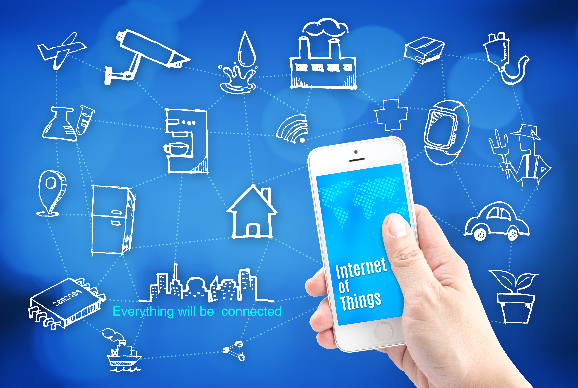
INTERNET OF THINGS
PROJECT ON SMART HEALTH MONITORING
SYSTEM
SUBMITTED BY :
CH.HYNDAVI
G.NIKHILA RANI
V.NAGA SAI ARUNA

Slide 2
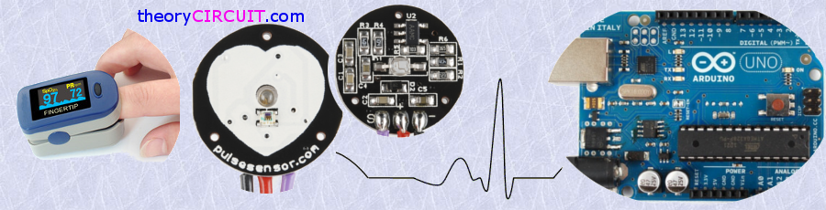
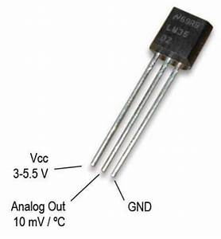
SMART HEALTH MONITORING SYSTEM
Continuous Heart Rate and Body Temperature Monitoring System Using Arduino UNO and ANDROID Device

Slide 3
Project Description
Monitoring health status of the patient at home is a difficult. Especially old age patients should be periodically monitored.
Our project puts forward a smart health monitoring system that uses Sensors to track health and alerts the care takers in case of emergencies.
By using sensors we can check the health parameters, these sensor values are sent to IBM Watson cloud and those values are stored in the database.
These values are then visualized on the user interface which is created using node red of IBM Watson services. These values are also sent to mobile application .

Slide 4
Project Highlights
Working with IBM Watson cloud services
Accessing Sensor data from anywhere in the world.
Reduces the need for a caretaker to be assigned to each patient.
Even the Family members can monitor the health status of their loved ones from anywhere in the world.

Slide 5
Block Diagram :
Pulse
A
R
D
U
I
N
O
-
UNO
NRF
TRANS-MITTER
NRF
RECIE-
VER
NODE
MCU
CLOUD
Temperature

Slide 6
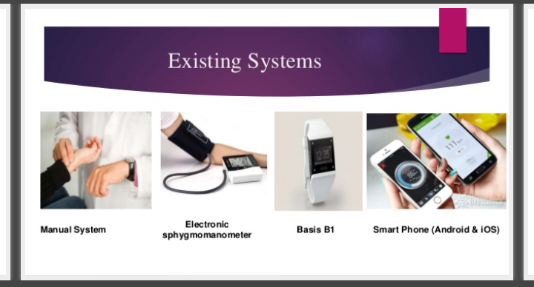

Slide 7
Why and Where???
Pulse sensor can be used by students , artists , makers , game and mobile developers.
Body temperature is used, at which the measurement is made at the subject’s state of consciousness.
We can easily incorporate live heart-rate and body temperature data in their projects.
we can use this in various medical purposes.
whenever there is case of emergency notifications are sent to desired persons.

Slide 8
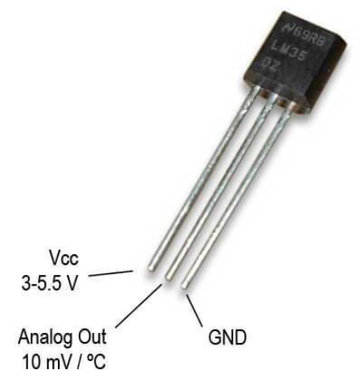
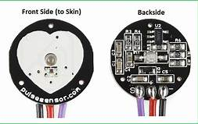
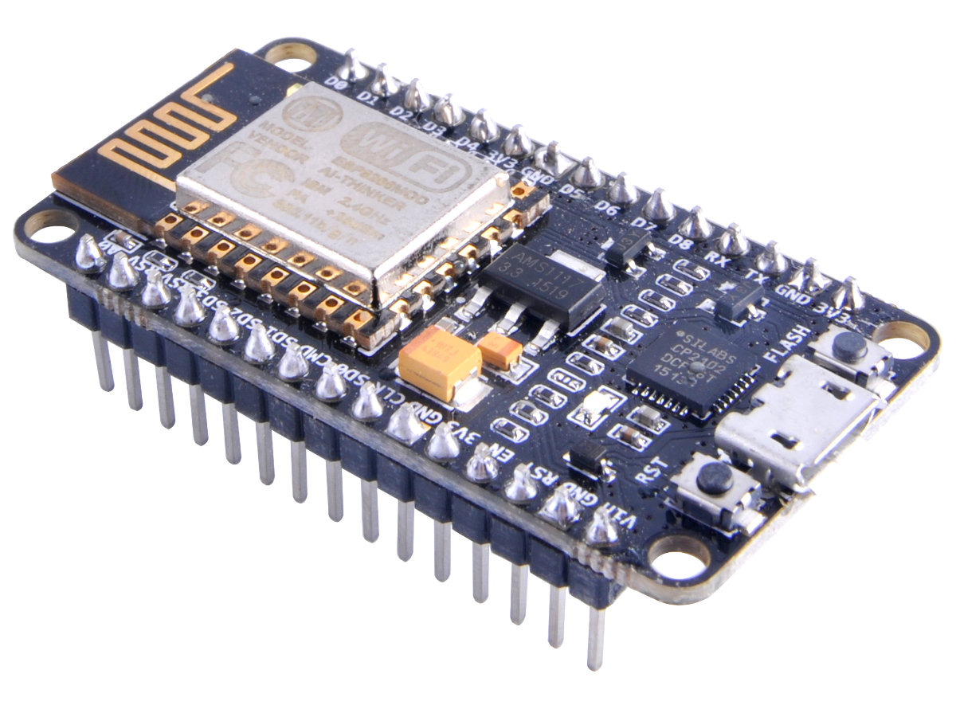
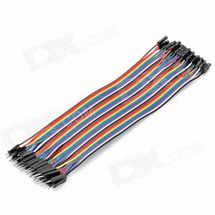
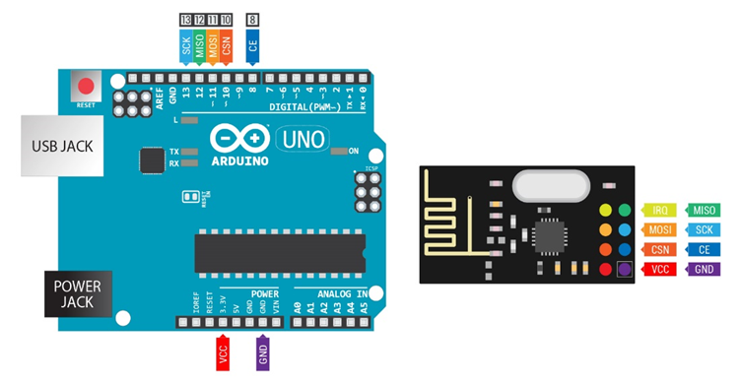
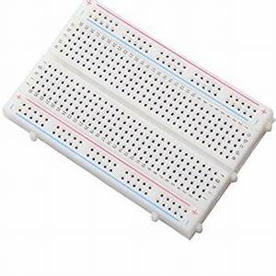
HARDWARE REQUIRED
PULSE SENSOR
NODEMCU
LM35
CONNECTINGWIRES
ARDUINO NRF24L01
BREAD BOARD

Slide 9
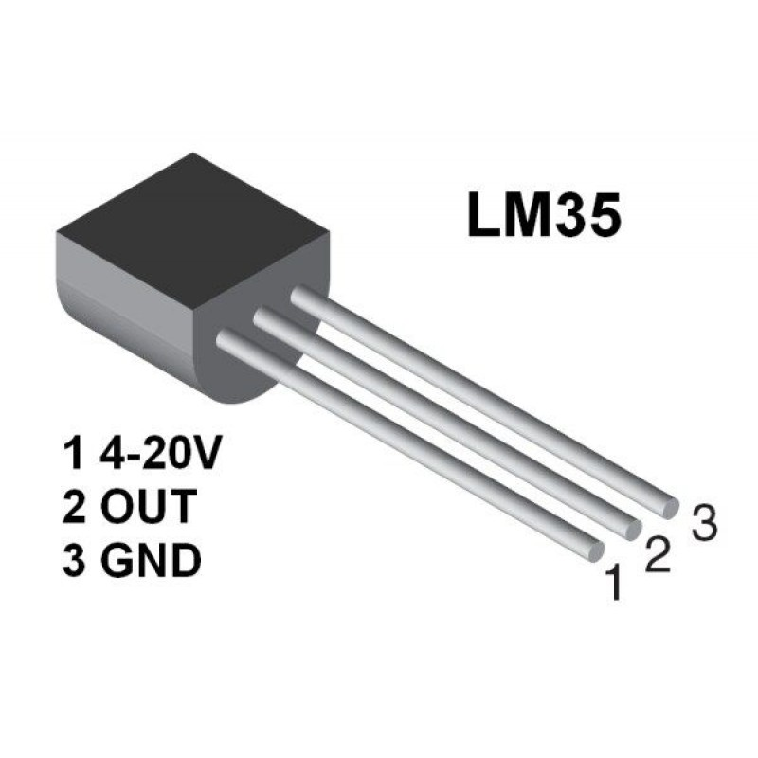
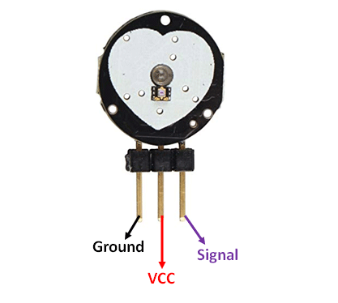
1. LM35 :
LM35 is a precision IC temperature sensor with its output proportional to the temperature.
The temperature can be measured more accurately.
The operating temperature range is from -55°C to 150°C.
The LM35 IC has 3 pins-2 for the power supply and one for the analog output.It is a low voltage IC which uses approximately +5VDC of power
2. PULSE SENSOR :
Pulse sensor is a plug and play heart-rate sensor for Arduino.
Tap the Pulse Sensor to finger tip, which is connected to Arduino, hence we can read heart-rate.
Working voltage :- 5V.
Working current :- 4mA.

Slide 10

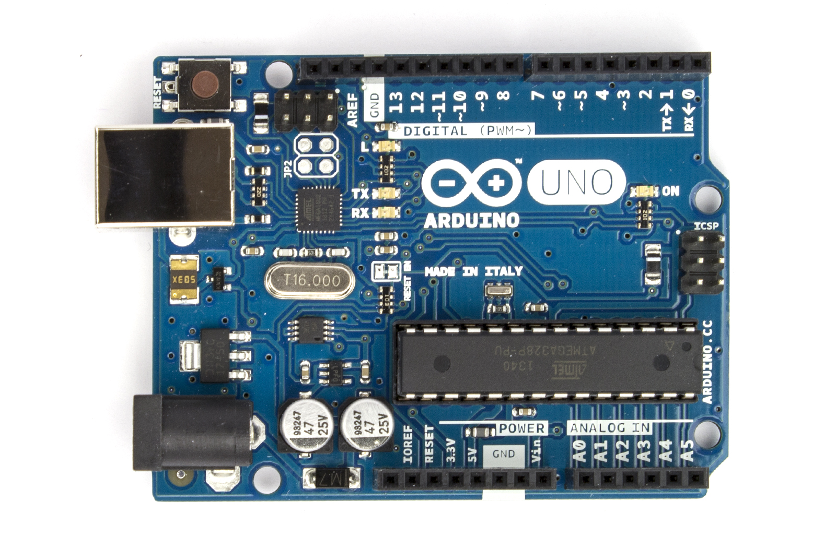
3.NODEMCU :
NODEMCU is an open source IOT platform.
It includes firmware which runs in the ESP8266 WiFi.
Hardware based on ESP-12 module.
Memory – 128kbytes.
4.ARDUINO UNO :
ARDUINO UNO is an open source micro controller board based on micro chip ATmega328P micro controller.
It is developed by Arduino.cc
Board is equipped with sets of digital and analog input/output pins that may be interfaced to various expansion boards and other circuits.
It communicates using the original STK500 protocol.

Slide 11
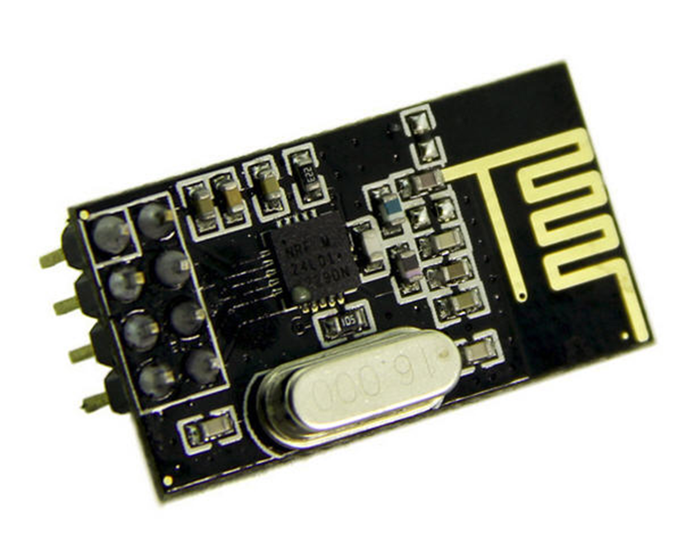
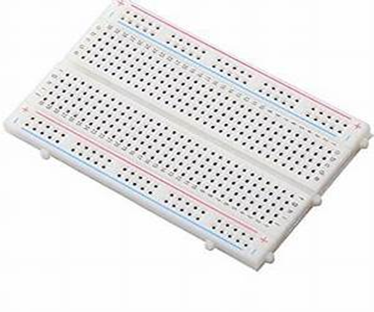
NRF24L01 :
NRF24l01 is used on a wide variety of applications that requires wireless control.
NRF24L01 is a single chip radio transceiver for the world wide 2.4 - 2.5GHz ISM band.
Ultra low power consumption
Input voltage : 3.3V
Pins : 5v tolerant
BREADBOARD :
Bread boards are one of the most fundamental pieces when learning how to built circuits.
Bread board is a construction base for prototyping of electronics .
It is reusable.
It is easy to use for creating temporary prototypes and experimenting with circuit design.

Slide 12
What we have done in this project
We have taken two sensors (i.e.)pulse sensor and temperature sensor.
We integrate two codes related to pulse sensor with interrupt code and temperature sensor , along with nRF transmitter .
Board – Arduino/ Geniuno UNO
PORT – COM4 Arduino/ Geniuno UNO
We have taken another nRF receiver code .
Sensor values can be transferred from nRF transmitter to nRF receiver(connected to nodeMCU).
Sensor values are sent to IBM Watson cloud and those values are stored in the database.
These values are then visualized on the user interface which is created using node red of IBM Watson services.
These values are also sent to mobile application.

Slide 13
Advantages :
We can access this device anywhere in the world.
We can also check the health status of our family members.
We can carry this device easily.
Maintainence will be easy.
We can know health status of our family members even we are far away from them.
This device an ecofriendly in nature.
Especially for doctor’s this device will be more useful.
For elderly people this project will be more helpful.

Slide 14
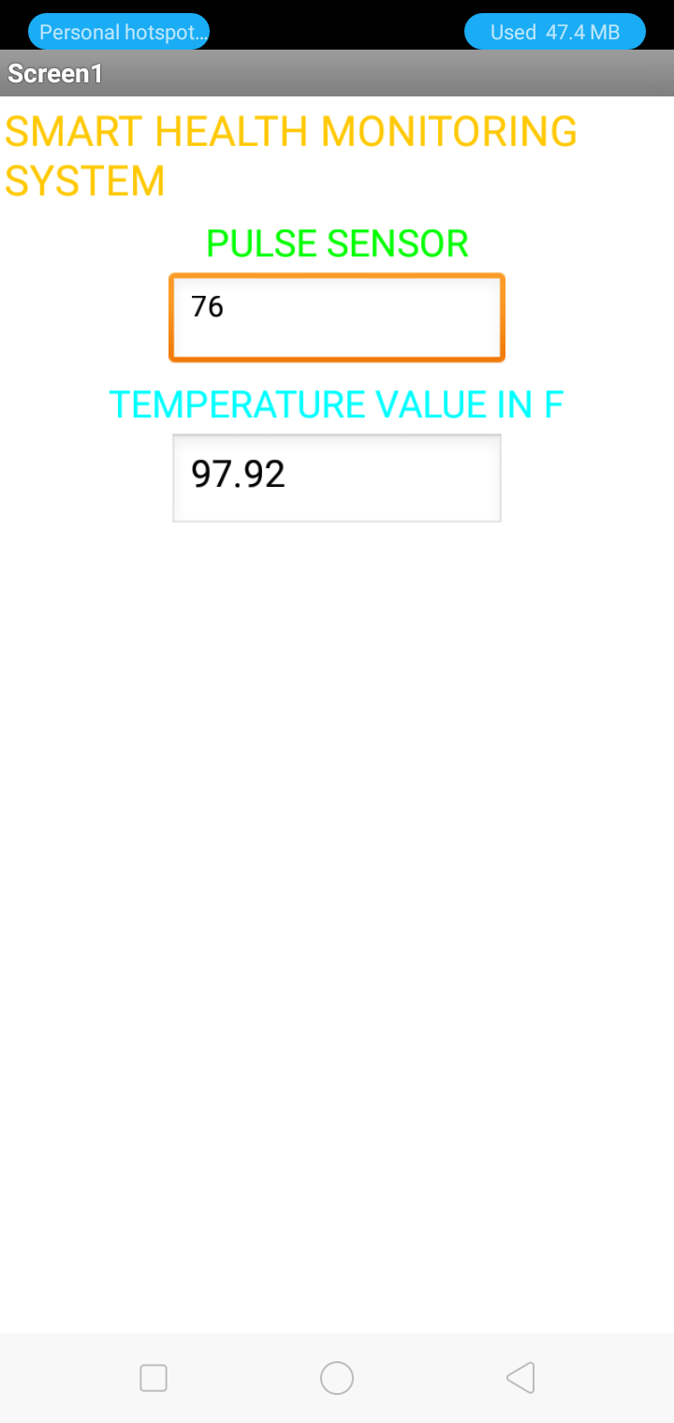
OUTPUT :

Slide 15
THANK YOU

